Slide 1


Slide 2
SAVING MADE FUN

Slide 3
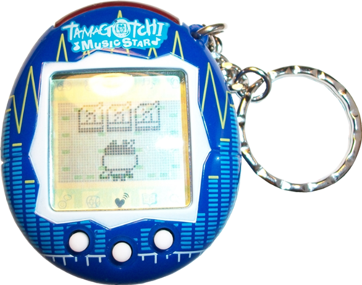

As of 2010, over 76 Million Tamagotchis sold.
Pokémon has a net value of 5.1 billion dollars.

Slide 4
Mobile Banking
52% of smartphone owners use Mobile Banking
51% increase from last year
94% of users use their phone to check their accounts and balance
Mobile Gaming
Average mobile gamer is 31 years old
29% of mobile gamers under the age of 18

